Slide 1


CSE 446/598 Software Integration and Engineering
Unit 1 Service Standards and Service Development
Lecture 1-5 RESTful Services
Development and Case Studies
Dr. Yinong Chen
https://myasucourses.asu.edu/

Slide 2
Lecture Roadmap
Developing REST Services:
Developing RESTful Service
Defining Input and Output Formats
Case Study: Image Verifier in RESTful Service
RESTful Service of a Random String Generator
RESTful Service of an Image Verifier
Synchronous RESTful Service Calls
Case Study: Consuming Services a Phone App
Asynchronous SOAP Calls
Asynchronous RESTful Calls
RESTful services in ASP .Net Core (2nd Generation)

Slide 3
Last Lecture: Convert a SOAP Service to a RESTful Service
Textbook Chapter 7.3 on RESTful services
Create a SOAP-based Service in WCF;
Use a client to test the service to make sure it works;
Convert the SOAP-based Service into a RESTful service in follow steps:
Add “using Sytem.ServiceModel.Web” in file IService.cs;
Add the attributes [WebGet] for each operation contract
Add the following line in the service’s markup source code Factory="System.ServiceModel.Activation.WebServiceHostFactory"
Remove SOAP endpoint for access, so that HTTP can be directly used for accessing the service.

Slide 4
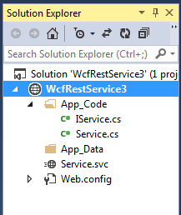
Step 2: IService.cs
using System;
using System.ServiceModel;
using System.ServiceModel.Web;
[ServiceContract]
public interface Iservice {
[OperationContract]
[WebGet] // Add this HTTP GET attribute/directive
int absValue(int x); [OperationContract]
[WebGet(ResponseFormat = WebMessageFormat.Xml)]
double PiValue();
[OperationContract]
[WebGet(UriTemplate = "add2?x={x}&y={y}", ResponseFormat = WebMessageFormat.Json)]
int addition(int x, int y);
}
Add HTTP Get method and UriTemplate
What is the difference of defining UriTemplate?
To be answered later.
add2 and addition are different

Slide 5
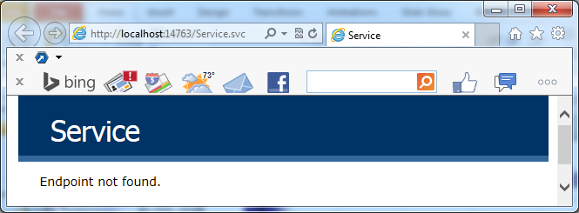
Testing the Service in Browser
View the Service in Browser
Test the service in browser
http://localhost:14763/Service.svc/PiValue it returns: <double>3.1415926535897931</double>
http://localhost:14763/Service.svc/absValue?x=-27
it returns: <int>27</int>
http://localhost:14763/Service.svc/add2?x=15&y=17 it returns: 32
[WebGet(UriTemplate = "add2?x={x}&y={y}", ResponseFormat = WebMessageFormat.Json)]
Hide the method name: Focus on the resource, instead of operations

Slide 6
Creating RESTful Service without Using IService
We define interface in Service.cs
using System; using System.ServiceModel; // Service.cs file
using System.ServiceModel.Activation; using System.ServiceModel.Web;
namespace RestService {
[ServiceContract]
[AspNetCompatibilityRequirements(RequirementsMode = AspNetCompatibilityRequirementsMode.Allowed)]
[ServiceBehavior(InstanceContextMode = InstanceContextMode.PerCall)]
//public class Service1 {
// Continued to next page
No end point will be created if IService.cs file is removed. You do not need to open Web.config file to remove endpoint.

Slide 7
RESTful Service: Using UriTemplate
http://msdn.microsoft.com/en-us/library/system.servicemodel.web.webgetattribute.aspx
public class Service1 {
[OperationContract]
[WebGet(ResponseFormat = WebMessageFormat.Xml)]
public double PiValue() {
double pi = System.Math.PI; return (pi);
}
[OperationContract]
[WebGet] // Not use a UriTemplate, simply use default
public int absValue(int x) {
if (x >= 0) return (x); else return (-x);
}
[OperationContract]
[WebGet(UriTemplate = “add2?x={x}&y={y}", ResponseFormat = WebMessageFormat.Json)] // Add this HTTP GET attribute/directive
public int addition(int x, int y) { return (x+y); }
}
}
Define Xml data format
Define two parameters
Define Json data format

Slide 8
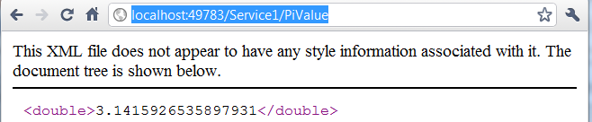
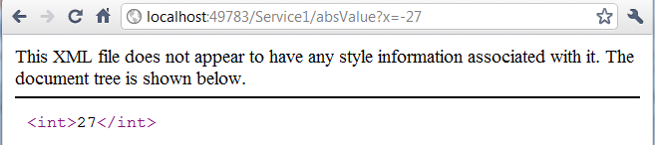
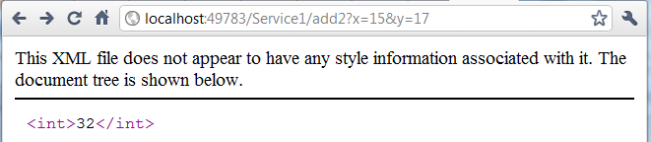
Testing Service Operations in Browser
Default parameter passing style

Slide 9
Access the Deployed Services
The service is deployed to ASU Service Repository at the address:
http://neptune.fulton.ad.asu.edu/WSRepository/Services/WcfRestService4/Service1/
We can test the remote service by replacing http://neptune.fulton.ad.asu.edu/WSRepository/Services/WcfRestService4/Service1/add2?x=15&y=17 for “localhost:49783”:

Slide 10
Lecture Roadmap: Case Study 1
Developing REST Services:
Developing RESTful Service
Defining Input and Output Formats
Image Verifier in RESTful Service
RESTful Service of a Random String Generator
RESTful Service of an Image Verifier
Synchronous RESTful Service Calls
Consuming Services in Silverlight / Phone Apps
Asynchronous SOAP Calls
Asynchronous RESTful Calls
RESTful services in ASP .Net Core (2nd Generation)

Slide 11
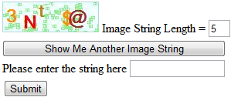
Development of an Image Verifier
Image verifiers have been widely used as a way of preventing programmed attached to Web sites.
An image verifier consists of a random string generator and an image generator.
Generate an image containing a string
Image Generator
Random String Generator
Enter the string shown in the image

Slide 12
Architecture Design of the Image Verifier
Composition Architecture Styles
Choreography
Services are allowed to communicate with each other
Orchestration
RESTful Service
RESTful Service
Image Generator
Random String Generator
ASP .Net Web Application

Slide 13
Architecture Design of the Image Verifier
Composition Architecture Styles
Choreography
Orchestration Services communicate with a central process only
RESTful Service
RESTful Service
Image Generator
Random String Generator
ASP .Net Web Application

Slide 14
Lecture Roadmap
Developing REST Services:
Developing RESTful Service
Defining Input and Output Formats
Image Verifier in RESTful Service
RESTful Service of a Random String Generator
RESTful Service of an Image Verifier
Synchronous RESTful Service Calls
Consuming Services in Silverlight / Phone Apps
Asynchronous SOAP Calls
Asynchronous RESTful Calls
RESTful services in ASP .Net Core (2nd Generation)

Slide 15

Example: Random String Generator
A RESTful service deployed at:
http://neptune.fulton.ad.asu.edu/WSRepository/Services/RandomString/Service.svc/
It has two operations:
Take an integer (length) as input, it returns a random string of the given length
Without providing a parameter, it returns a random string with a random length between 4 and 20.
The random string will contain an uppercase letter, a lowercase letter, a digit, and a special character. It can be used as a strong password.
It can be accessed in URI:
http://neptune.fulton.ad.asu.edu/WSRepository/Services/RandomString/Service.svc/GetRandomString/5
http://neptune.fulton.ad.asu.edu/WSRepository/Services/RandomString/Service.svc/GetRandomString

Slide 16
Random String Generator: IService.cs
using System; using System.ServiceModel;
using System.ServiceModel.Web;
[ServiceContract]
public interface IService {
[WebGet(UriTemplate = "/GetRandomString", RequestFormat = WebMessageFormat.Xml, ResponseFormat = WebMessageFormat.Xml, BodyStyle = WebMessageBodyStyle.Bare)]
string GetRandomString0();
[WebGet(UriTemplate = "/GetRandomString/{Length}", RequestFormat = WebMessageFormat.Xml, ResponseFormat = WebMessageFormat.Xml, BodyStyle = WebMessageBodyStyle.Bare)]
string GetRandomString(string Length);
}
We are using the style with svc endpoints created but disabled
Names must be different: cannot overload
Name to be used in URI can be the same
Names to be used in URI can be the same
Name must be different

Slide 17
Lecture Roadmap
Developing REST Services:
Developing RESTful Service
Defining Input and Output Formats
Image Verifier in RESTful Service
RESTful Service of a Random String Generator
RESTful Service of an Image Verifier
Synchronous RESTful Service Calls
Consuming Services in Silverlight / Phone Apps
Asynchronous SOAP Calls
Asynchronous RESTful Calls
RESTful services in ASP .Net Core (2nd Generation)

Slide 18
Image Verifier Interface: IService.cs
using System; using System.IO;
using System.ServiceModel;
using System.ServiceModel.Web;
[ServiceContract]
public interface IService {
[WebGet(UriTemplate = "/GetVerifierString/{myLength}", RequestFormat = WebMessageFormat.Xml, ResponseFormat = WebMessageFormat.Xml, BodyStyle = WebMessageBodyStyle.Bare)]
string GetVerifierString(string myLength); // generate a string
[WebGet(UriTemplate = "/GetImage/{myString}", RequestFormat = WebMessageFormat.Xml, ResponseFormat = WebMessageFormat.Xml, BodyStyle = WebMessageBodyStyle.Bare)]
Stream GetImage(string myString); // generate image of the string
}
This operation will call the RandomString/Service.svc

Slide 19
Image Verifier: Service.cs Architecture
RESTful service
Class Service
GetVerifierString (length)
{
call remote service;
return string;
}
RESTful service
Class Service
/Service.svc/ GetRandomString
/Service.svc/ GetRandomString/5
Return a
random string
GetImage(string)
{
generate image;
return image URI;
}

Slide 20
Image Verifier: Service.cs Code (1)
Notice how a RESTful service is access here
public class Service : IService {
public string GetVerifierString(string myLength) {
// Create the base address to the RandomString service
Uri baseUri = new Uri("http://neptune.fulton.ad.asu.edu/WSRepository/Services/RandomString/Service.svc");
// Define UriTemplate for passing parameter
UriTemplate myTemplate = new UriTemplate("GetRandomString/{Length}");
// Assign values to variable to obtain the complete URI
Uri completeUri = myTemplate.BindByPosition(baseUri, myLength);
WebClient channel = new WebClient(); // create a channel
byte[] abc = channel.DownloadData(completeUri); // return byte array
Stream strm = new MemoryStream(abc); // convert to mem stream
DataContractSerializer obj = new DataContractSerializer(typeof(string));
string randString = obj.ReadObject(strm).ToString();
return randString;
}
1
2
3
4
5
6
7
8
9
The purpose is to create a language-independent string

Slide 21
Image Verifier: Service.cs Code (1) Explained
http://neptune.fulton.ad.asu.edu/WSRepository/Services/RandomString/Service.svc/GetRandomString/5
From the previous page:
// Create the base address to the RandomString service
Uri baseUri = new Uri("http://neptune.fulton.ad.asu.edu/WSRepository/Services/RandomString/Service.svc");
// Create the Template to be used by the client
UriTemplate myTemplate = new UriTemplate("GetRandomString/{Length}");
// Assign values to variable to obtain the complete URI
Uri completeUri = myTemplate.BindByPosition(baseUri, myLength);
1
2
3
Can we use string appending, instead?
Uri completeUri = baseUri + myLength;

Slide 22
Image Verifier: Service.cs Architecture
RESTful service
Class Service
GetVerifierString (length)
{
call remote service;
return string;
}
RESTful service
Class Service
/Service.svc/ GetRandomString
/Service.svc/ GetRandomString/5
Return a
random string
GetImage(string)
{
generate image;
return image URI;
}

Slide 23
Image Verifier: Service.cs Code (2)
25 * stringLength
40
// This operation creates image based on the input string
public Stream GetImage(string myString) {
WebOperationContext.Current.OutgoingResponse.ContentType = "image/jpeg";
int mapwidth = (int)(myString.Length * 25); // define bitmap width
Bitmap bMap = new Bitmap(mapwidth, 40); // based on string length
Graphics graph = Graphics.FromImage(bMap);
graph.Clear(Color.Azure); // background color
graph.DrawRectangle(new Pen(Color.LightBlue, 0), 0, 0, bMap.Width - 1, bMap.Height - 1); // draw a frame
We have two variables: bMap and graph. We use graph variable to modify bMap.

Slide 24

Image Verifier: Service.cs Code (3)
We continue to use graph to modify bMap variable.
Random rand = new Random();
Pen badPen = new Pen(Color.LightGreen, 0);
for (int i = 0; i < 100; i++) { // create random noise pattern
int x = rand.Next(1, bMap.Width - 1);
int y = rand.Next(1, bMap.Height - 1);
graph.DrawRectangle(badPen, x, y, 4, 3);
graph.DrawEllipse(badPen, x, y, 2, 3); // position and size
}
char[] charString = myString.ToCharArray();
Font font = new Font("Boopee", 18, FontStyle.Bold);
Color[] clr = {Color.Black, Color.Red, Color.DarkViolet, Color.Green, Color.DarkOrange, Color.Brown, Color.DarkGoldenrod, Color.Plum };
Define an array of different colors

Slide 25

Image Verifier: Service.cs Code (4)
// Draw the characters in the string onto the graphics object
for (int i = 0; i < myString.Length; i++) {
int d = rand.Next(20, 25); // distance between characters
int p = rand.Next(1, 15); // up and down position
int c = rand.Next(0, 7); // randomly choose a color
string str1 = Convert.ToString(charString[i]); //char-string
Brush b = new System.Drawing.SolidBrush(clr[c]);
graph.DrawString(str1, font, b, 1 + i * d, p);
}
System.IO.MemoryStream ms = new System.IO.MemoryStream();
bMap.Save(ms, System.Drawing.Imaging.ImageFormat.Jpeg);
ms.Position = 0;
graph.Dispose(); bMap.Dispose();
return ms; // return the image generated
}
}
Now, we save bMap into memory string variable ms

Slide 26
Lecture Roadmap
Developing REST Services:
Developing RESTful Service
Defining Input and Output Formats
Image Verifier in RESTful Service
RESTful Service of a Random String Generator
RESTful Service of an Image Verifier
Synchronous RESTful Service Calls
Consuming Services in Silverlight / Phone Apps
Asynchronous SOAP Calls
Asynchronous RESTful Calls
RESTful services in ASP .Net Core (2nd Generation)

Slide 27
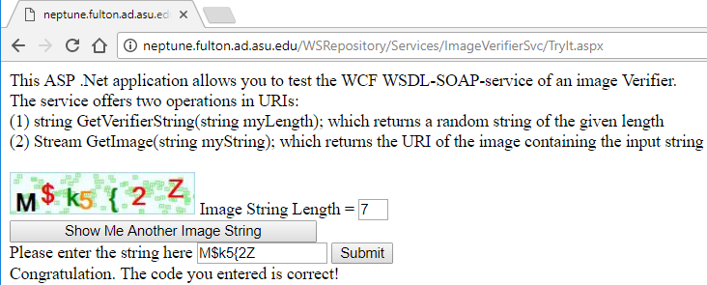
GUI Design
http://neptune.fulton.ad.asu.edu/WSRepository/Services/ImageVerifierSvc/TryIt.aspx

Slide 28
Code Behind the GUI: TryIt.aspx.cs (1)
using System; using System.Net; using System.IO;
using System.Runtime.Serialization;
public partial class TestVerifier : System.Web.UI.Page {
protected void Page_Load(object sender, EventArgs e) { }
protected void btnVerifyImage_Click(object sender, EventArgs e) {
if (Session["generatedStr"].Equals(TextBox1.Text)) {
Label1.Text = "Congratulation. The code you entered is correct!";
}
Else {
Label1.Text = "I am sorry, the string you entered does not match the image. Please try again!";
}
}

Slide 29
Code Behind the GUI: TryIt.aspx.cs (2)
protected void btnGetImage_Click(object sender, EventArgs e) {
// create the base address
Uri baseUri = new Uri("http://neptune.fulton.ad.asu.edu/WSRepository/Services/ImageVerifier/Service.svc/");
// create the path from tree root to the child node
UriTemplate myTemplate = new UriTemplate("GetVerifierString/{myLength}");
// Assign values to variable to complete URI
Uri completeUri = myTemplate.BindByPosition(baseUri, txtBoxlength.Text);
Prepare the URI to call the GetImage service

Slide 30
Code Behind the GUI: TryIt.aspx.cs (3)
call the service GetVerifierString
WebClient channel = new WebClient();
byte[] abc = channel.DownloadData(completeUri);
Stream strm = new MemoryStream(abc);
DataContractSerializer obj = new DataContractSerializer(typeof(string));
string generatedString = obj.ReadObject(strm).ToString();
Session["generatedStr"] = generatedString; // Save
Image1.Visible = true;
Image1.ImageUrl = "http://neptune.fulton.ad.asu.edu/WSRepository/Services/ImageVerifier/Service.svc/GetImage/" +
generatedString;
btnGetImage.Text = "Show Me Another Image String";
}
}
call the service GetImage and return image
Read textbook Chapter 5 on image generation for full detail

Slide 31
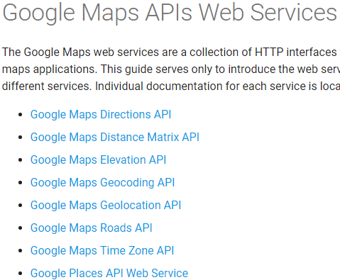
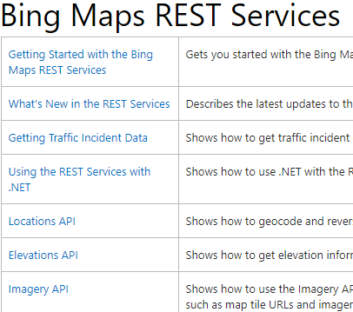
Google and Microsoft RESTful Services
Example in Text Section 7.3.6
Google map services
https://developers.google.com/maps/documentation/webservices/
Microsoft Bing map services
http://msdn.microsoft.com/en-us/library/ff701713.aspx

Slide 32
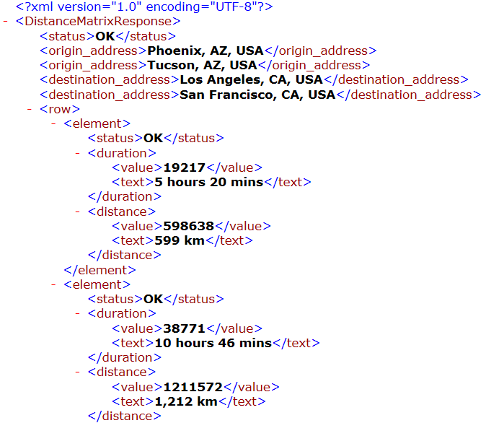
Google Map Service Call Example
http://maps.googleapis.com/maps/api/distancematrix/xml?origins=Phoenix+AZ|Tucson+AZ&destinations=Los+Angeles|San+Francisco%&mode=driving&language=en&sensor=false
Distance / Time | Los Angeles | San Francisco
Phoenix
Tucson

Slide 33
Lecture Roadmap: Case Study 2
Developing REST Services:
Developing RESTful Service
Defining Input and Output Formats
Image Verifier in RESTful Service
RESTful Service of a Random String Generator
RESTful Service of an Image Verifier
Synchronous RESTful Service Calls
Consuming Services in a Phone App
Asynchronous SOAP Calls
Asynchronous RESTful Calls
RESTful services in ASP .Net Core (2nd Generation)

Slide 34
Asynchronous for Mobile Communication
Why is asynchronous communication important in mobile communication?
Mobile devices use wireless communication.
It has a higher network transient error rate.
Asynchronous communication split a longer communication period into two shorter periods.
It is less vulnerable to transient errors

Slide 35
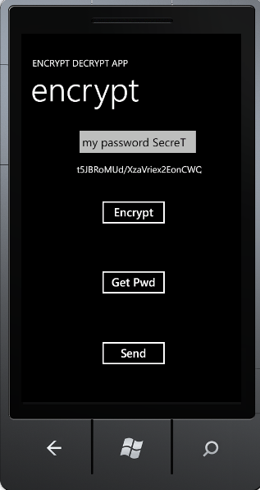
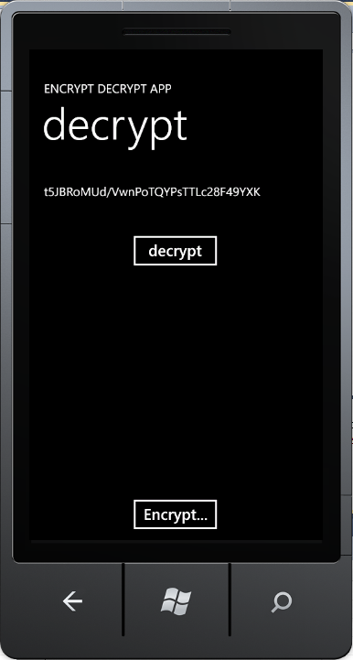
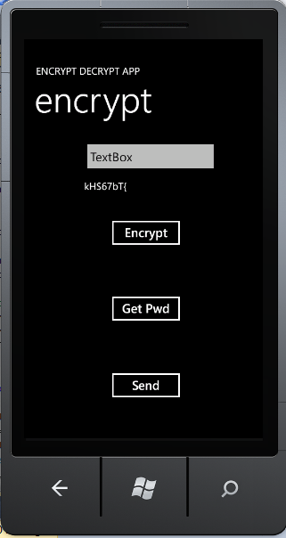

Case Study: Secure Phone Messenger
Phone apps rely on Web services to provide necessary functionalities;
Develop a secure phone messenger among friends and business partner

Slide 36
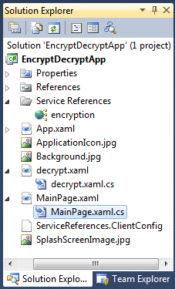
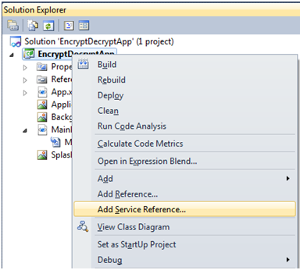
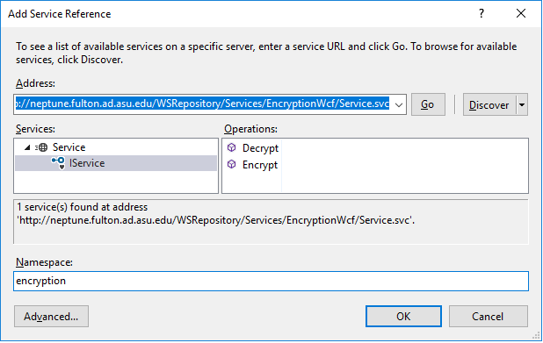
Add Encryption/Decryption SOAP Service

Slide 37


Code Behind GUI: Encrypt.xaml.cs
// namespace EncryptDecryptApp {
private void Encrypt_Click(object sender, RoutedEventArgs e) {
string msg1 = textBox1.Text;
encryption.ServiceClient prxyEncrypt = new encryption.ServiceClient();
prxyEncrypt.EncryptCompleted += new EventHandler <EncryptCompletedEventArgs>(EncryptEventhandler); //add callback event hdler
prxyEncrypt.EncryptAsync(msg1); // After service call complete
EventHandler<System.ComponentModel.AsyncCompletedEventArgs> (prxyEncrypt_CloseCompleted);
}
private void EncryptEventhandler(object sender, EncryptCompletedEventArgs e) {
textBlock1.Text = e.Result;
}
private void send_Click(object sender, RoutedEventArgs e) {
this.NavigationService.Navigate(new Uri("/decrypt.xaml?msg=" + textBlock1.Text, UriKind.Relative));
} } }
1
2
5
3
4
Callback
6
Could be a global URI

Slide 38
Making Asynchronous Call Using Event
encryption.ServiceClient prxyEncrypt = new encryption.ServiceClient();
1
Create prxyEncrypt
object
prxyEncrypt.EncryptCompleted event
prxyEncrypt.EncryptAsync( ) // service method
2
Add Event Handler
prxyEncrypt.EncryptCompleted event
EncryptEventhandler
5
prxyEncrypt.EncryptAsync( ) // service method
3
Call service and return
prxyEncrypt.EncryptAsync(msg1) // String to be encrypted
4
Service call completes
6
prxyEncrypt.EncryptAsync(msg1)
5
Trigger event
prxyEncrypt.EncryptCompleted event occur
6
// EncryptEventhandler Code
private void EncryptEventhandler(object sender, EncryptCompletedEventArgs e)
{
textBlock1.Text = e.Result;
}

Slide 39



Code Behind GUI: decrypt.xaml.cs
// namespace EncryptDecryptApp {
private void decrypt_Click(object sender, RoutedEventArgs e) {
string msgEncrypted = textBlock1.Text;
encryption.ServiceClient prxyEncrypt = new encryption.ServiceClient();
prxyEncrypt.DecryptCompleted += new EventHandler<DecryptCompletedEventArgs>(prxyEncrypt_DecryptAsync);
prxyEncrypt.DecryptAsync(msgEncrypted);
}
private void prxyEncrypt_DecryptAsync(object sender, DecryptCompletedEventArgs e) {
textBlock1.Text = e.Result;
}
private void Encrypt_Click(object sender, RoutedEventArgs e) {
string msg = "";
this.NavigationService.Navigate (new Uri("/MainPage.xaml?msg=" + msg, UriKind.Relative));
} } }
Could be a global URI

Slide 40
Lecture Roadmap
Developing REST Services:
Developing RESTful Service
Defining Input and Output Formats
Image Verifier in RESTful Service
RESTful Service of a Random String Generator
RESTful Service of an Image Verifier
Synchronous RESTful Service Calls
Consuming Services in Phone Apps
Asynchronous SOAP Calls
Asynchronous RESTful Calls
RESTful services in ASP .Net Core (2nd Generation)

Slide 41
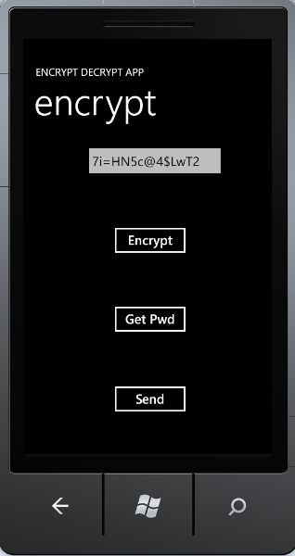
Calling RESTful Service from Silverlight App
http://www.public.asu.edu/~ychen10/teaching/cse446sie/AsyncRest.mp4
The RESTful service to call is
http://neptune.fulton.ad.asu.edu/WSRepository/Services/RandomString/Service.svc/GetRandomString/ {length}
For example
http://neptune.fulton.ad.asu.edu/WSRepository/Services/RandomString/Service.svc/GetRandomString/14
It returns a “Strong Password” in XML format:
<string xmlns="http://schemas.microsoft.com/2003/10/Serialization/">
7i=HN5c@4$LwT2
</string>

Slide 42
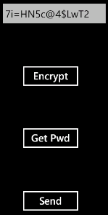
The Code Behind the Button “Get Pwd”
public static string spassword = "Waiting for call back"; //static-global
private void btnGetPwd_Click(object sender, RoutedEventArgs e)
{
Random rnd = new Random();
Int32 length = rnd.Next(6, 18); random # between 6 and 18
string toDisplay = spassword;
GetPwd(length); // It puts the result in spassword variable
// Async! It will not have the value in the next statement
if (spassword != "Waiting for call back")
{
XDocument xd = XDocument.Parse(spassword);
XElement xe = xd.Root;
toDisplay = xe.Value;
}
textBox1.Text = toDisplay;
}
button
Continued
on next
Page
We will obtain the password from the previous call, this this call!

Slide 43
The Code Behind the Button “Get Pwd”
public static void GetPwd(int length) {
string baseUrl = "http://neptune.fulton.ad.asu.edu/WSRepository/Services/RandomString/Service.svc/GetRandomString/";
string len = Convert.ToString(length);
string fullUrl = baseUrl + len;
HttpWebRequest hwReq1 = (HttpWebRequest)HttpWebRequest.Create(new Uri(fullUrl));
hwReq1.BeginGetResponse(new AsyncCallback(myCallbackFunc), hwReq1);
} // This method returns immediately
private static void myCallbackFunc(IAsyncResult requestObj) {
HttpWebRequest hwReq2 = (HttpWebRequest)requestObj.AsyncState;
HttpWebResponse hwResponse = (HttpWebResponse)hwReq2.EndGetResponse(requestObj);
using (StreamReader sReader = new StreamReader(hwResponse.GetResponseStream())) {
spassword = sReader.ReadToEnd().ToString();
// Result save into this static variable spassword
}
RESTful service
Create request object
Call handler
Make request
Get response
Extract string

Slide 44
The Code Explained
Create request object, but not calling
HttpWebRequest hwReq1 = (HttpWebRequest)HttpWebRequest.Create(new Uri(fullUrl));
hwReq1.BeginGetResponse(new AsyncCallback(myCallbackFunc), hwReq1);
} // This method returns immediately
private static void myCallbackFunc(IAsyncResult requestObj) {
HttpWebRequest hwReq2 = (HttpWebRequest)requestObj.AsyncState;
HttpWebResponse hwResponse = (HttpWebResponse)hwReq2.EndGetResponse(requestObj);
using (StreamReader sReader = new StreamReader(hwResponse.GetResponseStream())) {
spassword = sReader.ReadToEnd().ToString();
// Result save into this static variable spassword
}
Call handler, with callback func and the object
Object from caller
Make the request in async
Get the response from the request
Extract string
Save string into global variable

Slide 45
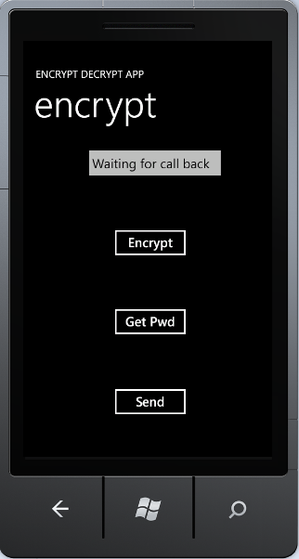
Demonstration First Call and Second Call
http://www.public.asu.edu/~ychen10/teaching/cse446sie/AsyncRest.mp4
We obtain the password from the previous call, this this call!
First Call
Second Call

Slide 46
Lecture Roadmap
Developing REST Services:
Developing RESTful Service
Defining Input and Output Formats
Image Verifier in RESTful Service
RESTful Service of a Random String Generator
RESTful Service of an Image Verifier
Synchronous RESTful Service Calls
Consuming Services in Phone Apps
Asynchronous SOAP Calls
Asynchronous RESTful Calls
RESTful services in ASP .Net Core (2nd Generation)

Slide 47
ASP .Net Core Framework: The 2nd Generation
WCF RESTful Service
ASP .Net MVC 1 Application
Web API
RESTful Service
ASP .Net Core Web Application MVC
ASP .Net Web Application
WCF SOAP Service
HTML5
Single Page Application with Client Side Computing
ASP .Net SOAP Service
HTML CSS
Java-Script &
JQuery
Canvas SVG WebGL
Desktop-based Forms Application
ASP .Net Framework
ASP .Net Core Framework
Other Frameworks
such as Netbeans

Slide 48
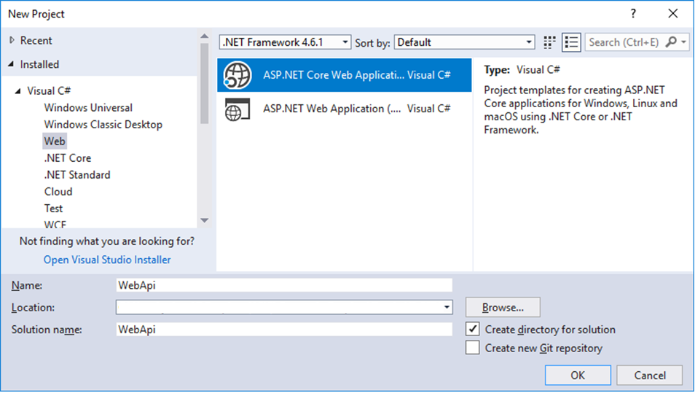
Using ASP .Net Core Web Application
New → Project …
Choose your directory for storing your project

Slide 49
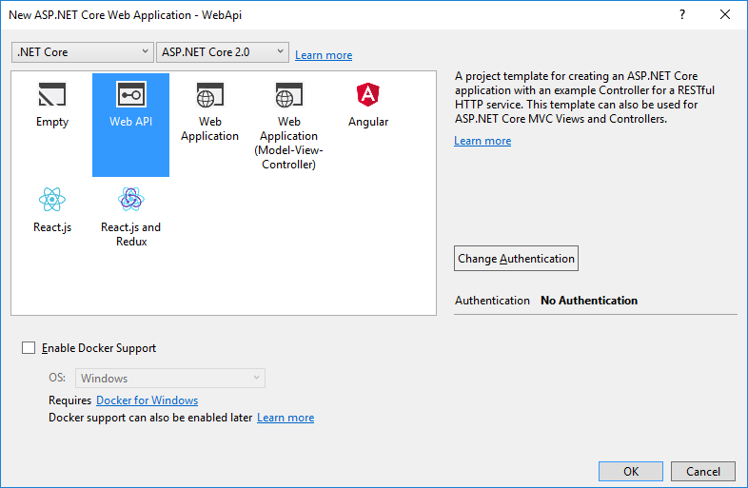
Choose Web API Template

Slide 50
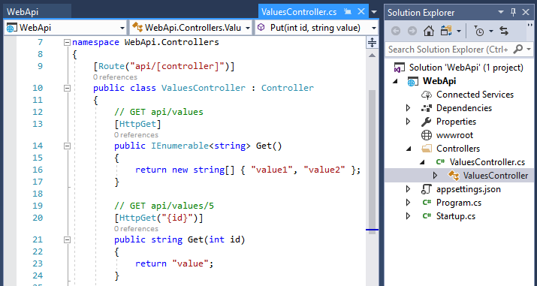
Service Templates, Add Your Code …

Slide 51
Lecture Summary
Developing REST Services:
Developing RESTful Service
Defining Input and Output Formats
Image Verifier in RESTful Service
RESTful Service of a Random String Generator
RESTful Service of an Image Verifier
Synchronous RESTful Service Calls
Consuming Services in Phone Apps
Asynchronous SOAP Calls
Asynchronous RESTful Calls
RESTful services in ASP .Net Core (2nd Generation)

Slide 52
Next Lecture
WCF RESTful Service
ASP .Net MVC 1 Application
Web API
RESTful Service
ASP .Net Core Web Application MVC 2
ASP .Net Web Application
WCF SOAP Service
HTML5
Single Page Application with Client Side Computing
ASP .Net SOAP Service
HTML CSS
Java-Script &
JQuery
Canvas SVG WebGL
Desktop-based Forms Application
ASP .Net Framework
ASP .Net Core Framework
Other Frameworks
such as Netbeans

